Slide 1
Measurement uncertainty and error
SC12: I can communicate measurement uncertainties as a range (±) to an appropriate precision and calculate the measurement uncertainties in processed data, including the use of absolute uncertainties and percentage uncertainties

Slide 2
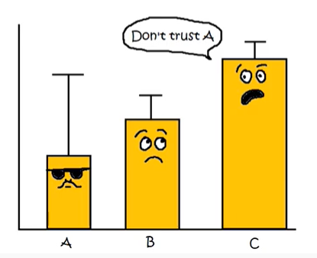
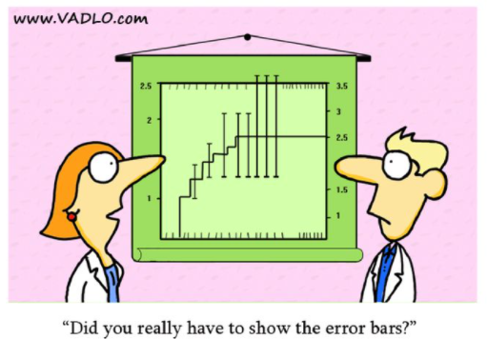
General info (not notes) – whenever you collect numerical data in science there is always the question of how accurate and how precise your number is. The words accurate and precision have some very broad meaning in general language, so in science, we use two very specific words – error and uncertainty.
Error describe the inaccuracy in a number. You can only identify error if you know what the number is supposed to be. Thus percentage error is only calculated at the end of an investigation when you compare your result to previous known results.
Uncertainty describes the precision of a number. It is written as an absolute value (using ±) or as a percentage. You can determine uncertainty two ways – from the instrument you used to measure the number, or from how much the number varies when you measure it in repeated trials. Uncertainty is calculated right from the very start of an experiment, and the uncertainty should be propagated through all the calculations used to get the results of the investigation. Therefore most of this PowerPoint is about uncertainty – it is more work!

Slide 3
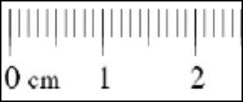
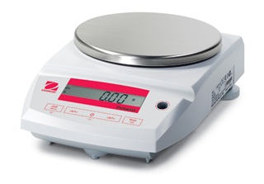
1. Measurement uncertainty – this is uncertainty created by the reading of the measuring instrument. Measurement uncertainty is always created whenever you record a measurement
Uncertainty – measurement and random
Example of measurement uncertainty –
We could measure a piece of magnesium as 2 cm long using a ruler on which the smallest division is 1 mm. The value is 2.0 cm. However there is uncertainty associated with the ruler. As it is an analogue instrument, this uncertainty is half the smallest increment of the scale.
The length of the Mg is therefore 2.0 ± 0.05 cm OR 2.0 cm ± 2.5%
Or, we could weigh the strip of magnesium ribbon on an electron balance to two decimal places. The mass was 0.27 g. However there is uncertainty associated with the balance. As it is a digital scale, this uncertainty is the smallest value of the scale.
The mass of the Mg is therefore 0.27 ± 0.01 g OR 0.27 g ± 4%
Absolute uncertainty
Relative uncertainty
Absolute uncertainty
Relative uncertainty
Why is this not 3.7%

Slide 4
2. Random uncertainty – this is uncertainty created by a range of trial data values which do not agree. Random uncertainty is always created whenever you average a range of trials.
$$random uncertainty=\frac{range}{2}$$
$$=\frac{highest trial −lowest trial}{2}$$
Example of random uncertainty –
If we were doing three trials of an experiment, we measure the mass of three pieces of magnesium. These are shown below.
The average mass is 0.28 (two significant figures). However there is now some uncertainty as not all the trials are the same. Random uncertainty is calculated from the range of the data divided by 2. The random uncertainty in the three masses is range divided by 2.0. This is 0.01g/2, or 0.05g. Therefore the mass of the magnesium is 0.28 ± 0.05 g OR 0.28 g ± 20%
Reading | Mass (g)
1 | 0.27
2 | 0.28
3 | 0.28
Average | 0.28
Absolute uncertainty
Relative uncertainty

Slide 5
When collecting raw data you must determine the
measurement uncertainty for your independent variable, and
the measurement uncertainty and the random uncertainty for your dependent variables.
Once you have both types of uncertainty for your dependent variable you then choose the greatest uncertainty. This is the uncertainty you propagate through to your secondary data (more on how to do that later).

Slide 6
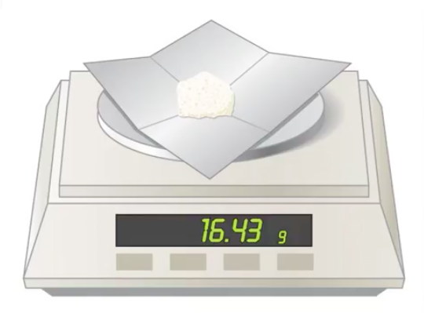
Estimating the measurement uncertainties associated with instruments.
The random uncertainty of a digital apparatus is ± the smallest scale division
What is the random uncertainty of this measurement?
16.43 ± ____ g
0.01
Absolute uncertainty

Slide 7
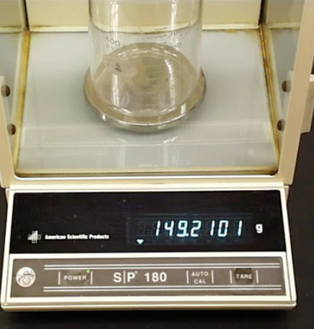
What is the random uncertainty of this measurement?
149.2101 ± _______ g
0.0001
Absolute uncertainty

Slide 8
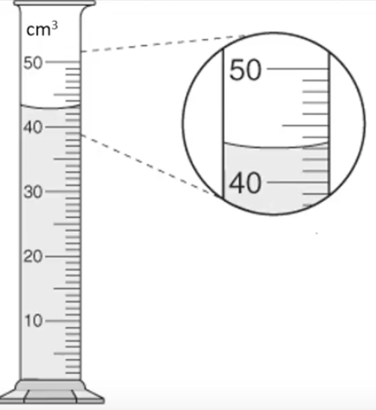
The random uncertainty of a analogue instruments is ± half the smallest division to which you take the reading.
What is the random uncertainty of this measurement?
43.0 ± ____ cm³
0.5
Absolute uncertainty

Slide 9
What is the random uncertainty of this measurement?
40.9 ± ____ mm
0.5
Absolute uncertainty

Slide 10
What is the random uncertainty of this measurement?
43.6 ± ____ cm³
0.05
Absolute uncertainty

Slide 11
Estimating the random uncertainty associated with trials.
There are occasions where measurement uncertainty is not a reliable guide to uncertainty. For example, if you were to time how long it took someone to run 20 metres, the digital stopwatch you used would have a measurement uncertainty of equal to its smallest scale. Therefore your measurement would look something like 3.5 ± 0.01s. It is very unlikely that the uncertainty in the time is actually 0.01s, as the human component in clicking the stopwatch would have introduced greater uncertainty than this. On occasions like this you can estimate the uncertainty caused by human actions, or more effectively, you can do repeated trials and calculate the random uncertainty for the range of the trials.
a) Calculate the average and the uncertainty for each set of data:
SET A: 15.32, 15.37, 15.33, 15.38, 15.35
SET B: 16.30, 16.19; 16.24 16.29, 16.23
b) The "true" value that we were attempting to measure was: 16.26
Which set of data is most precise? _______
Which was most accurate? _______

